Slide 1
Points from the past
Peter Guttorp
www.stat.washington.edu/peter
peter@stat.washington.edu

Slide 2
Joint work with
Thordis Thorarinsdottir, Norwegian Computing Center

Slide 3
The first use of a Poisson process
Queen’s College Fellows list:
1749-1764 John Michell, M.A., B.D., F.R.S. Taxor, Professor of Geology. Lecturer in Hebrew, Arithmetic, Geometry, and Greek. First person to describe the Inverse Square Law of magnetic action. First person to describe a black hole. d.1793.
1767 paper
Notes:
Cambridge No reliable picture found

Slide 4
The Pleiades
Taygeta
Maia
Alcyone
Electra
Atlas
Merope

Slide 5
Michell’s argument
If stars are gravitationally attracted, there should be more clusters than predicted by chance.
≈1500 stars equal in brightness to the six Pleiades
The distances of the other Pleiades from Maia are 11, 19.5, 24.5, 27 and 49 arc minutes.
If stars are scattered randomly, what is the probability of having 6 out of 1500 this close?
Notes:
Bayes’ theorem published three years before this

Slide 6
Calculations
Michell multiplies the probabilities of at least one point within the angles for each of the other stars.
Answer 1/496 000
But these are not disjoint sets. Correct answer 1/14 509 269.
Conclusion regardless: not likely by chance, so gravitation is a possibility.
Simon Newcomb did a similar computation in 1860, Pólya in 1919.

Slide 7
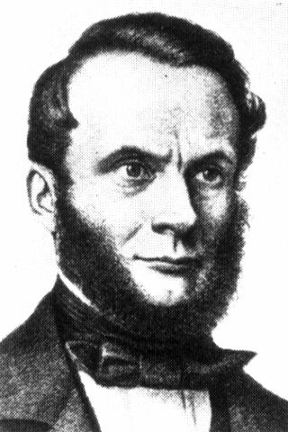
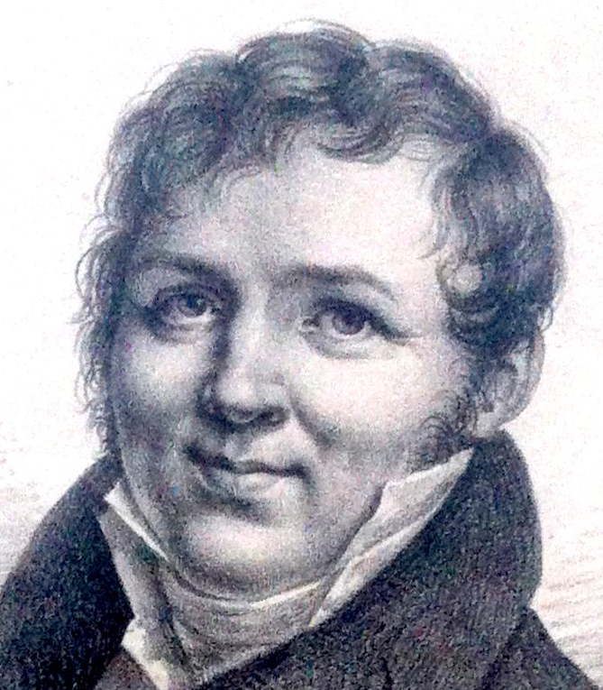
Other Poisson process calculations
Kinetic theory of heat: heat arises from molecules colliding
Objection: why don’t gases mix more rapidly?
Clausius (1858) calculates the law of distance between collisions and derives the zero probability of a Poisson process.
Rudolf Clausius
1822-1888
Siméon Poisson
1781-1840

Slide 8
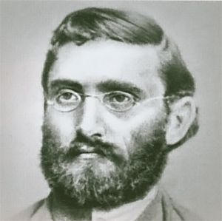
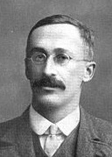
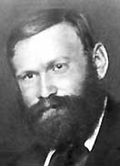
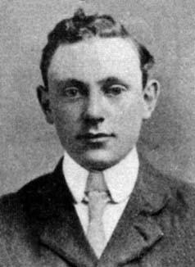
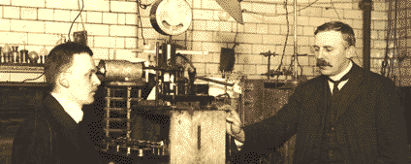
Abbe (1879) and Gossett (1907) compute distribution of cells on a microscope slide.
Erlang (1909) phone calls
Bateman (1914) alpha decay
Ernst Abbe
1840-1905
William Gossett
1876-1937
Agner Erlang
1878-1929
Harry Bateman
1882-1946
Ernest Rutherford (right)
1871-1937
Hans Geiger (left)
1882-1945

Slide 9
The derivation of the Poisson process
Lundberg (1903) insurance claims
Claim of size a_{i} with probability p_{i}dt in an interval of length dt
When all a_{i}=λ the pmf p of total claims is the solution to
which is the forward equation for the Poisson process.
In the case of general a_{i} he gets a compound Poisson process

Slide 10
Cluster processes
Primary (center) process
Secondary process
Notes:
Often Poisson primary. Distrinction clustered vs regular
Almost always independent clusters (and iid cluster sizes)

Slide 11
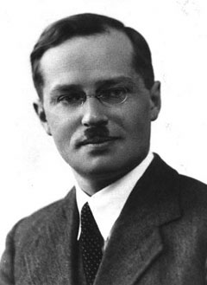
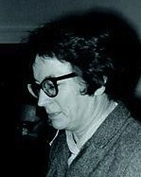
Neyman-Scott process
Neyman (1939) potato beetle larvae
Neyman & Scott (1952) clusters of galaxies
Not necessarily Poisson cluster centers
iid dispersions
Jerzy Neyman
1894-1981
Elizabeth Scott
1917-1988

Slide 12
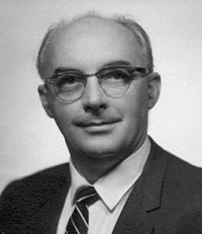
Doubly stochastic processes
Le Cam (1947) modeling precipitation (Halphen’s idea)
Shot noise (linear filter of Poisson process)
log Gaussian
Gauss-Poisson
Lucien Le Cam
1924-2000

Slide 13
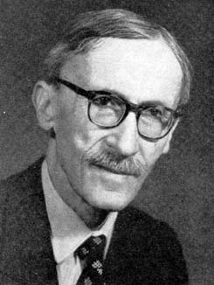
Markovian processes
Lévy (1948) Sharp Markov property: events outside and inside a set are independent given the boundary
All spatial processes with the sharp Markov property are doubly stochastic Poisson processes (Wang 1981)
Paul Lévy
1886-1971

Slide 14
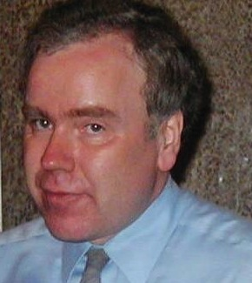
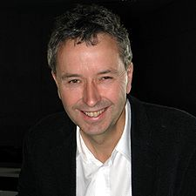
Ripley-Kelly approach
x pattern in S, y pattern in S-x
depends on y only through the neighbors of x
By Hammersley-Clifford, the density where the
interaction function φ(y)=1 unless all points in y are neighbors
Brian Ripley
1952-
Frank Kelly
1950-
Notes:
Def nbr by interaction, eg radius

Slide 15
Terminology history
Point pattern Eggenberger and Pólya 1923
Poisson process Feller, Lundberg 1940
Point process Palm 1943
Doubly stochastic Poisson process Bartlett 1963
Cox process Krickeberg 1972

Slide 16
Where we are now?
Over the last decades, much point process analysis has focused on
Markovian point process models
log-Gaussian doubly stochastic Poisson processes
Not directly driven by understanding of the underlying scientific phenomenon.
Analysis of spatial patterns has largely been done using isotropic second order parameters
Notes:
History of pp largely based on science

